Slide 1

Unabalanced Dataset Problem @DETERMINED 2022 Workshop
Dr. U. Michelucci (TOELT)

Slide 2
Learning Goals
Definition: Students are able to explain and recognize what an unbalanced dataset is. Consequences: Students are able to describe the challenges associated with unbalanced datasets. Strategies: Students are able to describe the two most important techniques for dealing with unbalanced datasets: under- and oversampling Metrics: Students understand the most important metrics that are especially important for unbalanced datasets.

Slide 3

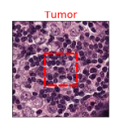
Problem Description – Classification in Practice (binary)
Classifier
Class: TUMOR
Class: NOT TUMOR
Target Labels
Classes
…
Input Data
Algorithm
Image Source: Kolawole, P. (2022). Convolutional Neural Network for Detecting Cancer Tumors in Microscopic Images. Retrieved 19 March 2022, from https://medium.com/swlh/convolutional-neural-network-for-detecting-cancer-tumors-in-microscopic-images-1acab6481d05

Slide 4
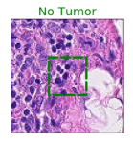
Problem Description – Classification in Practice (binary)
Classifier
Class: TUMOR
Class: NOT TUMOR
Target Labels
Classes
…
Input Data
Algorithm
Image Source: Kolawole, P. (2022). Convolutional Neural Network for Detecting Cancer Tumors in Microscopic Images. Retrieved 19 March 2022, from https://medium.com/swlh/convolutional-neural-network-for-detecting-cancer-tumors-in-microscopic-images-1acab6481d05

Slide 5
Datasets in der Praxis (hospital-acquired infections)
683 patients
Class 0 (Infected): 75 (11% of the total)
Class 1 (healthy): 608 (89% of the total)
Cohen, Gilles, et al. "Learning from imbalanced data in surveillance of nosocomial infection." Artificial intelligence in medicine 37.1 (2006): 7-18

Slide 6
Datasets in practice (Microsope images)
220,000 training images - 57,458 test images
Class 0 (no Tumor)
55% of images
Class 1 (Tumor)
45% of images
Image Source: Kolawole, P. (2022). Convolutional Neural Network for Detecting Cancer Tumors in Microscopic Images. Retrieved 19 March 2022, from https://medium.com/swlh/convolutional-neural-network-for-detecting-cancer-tumors-in-microscopic-images-1acab6481d05

Slide 7
Unbalanced Dataset
Put simply, an dataset is said unbalanced when the target variable has more observations in a particular class than in the others.

Slide 8
Unbalanced Dataset in Classification - Examples
Target Labels Distribution
50%
50%
<1%
>99%
Balanced Dataset
Unbalanced
Dataset

Slide 9
Quiz
Starting situation
Dataset: 1000 inputs in Class 1 (e.g. no tumor); 10 in Class 0 (e.g. tumor)
Trained model achieved: 99% accuracy
Question: What do you think of the model? Is it good? Ultimately, it achieves 99% accuracy!

Slide 10
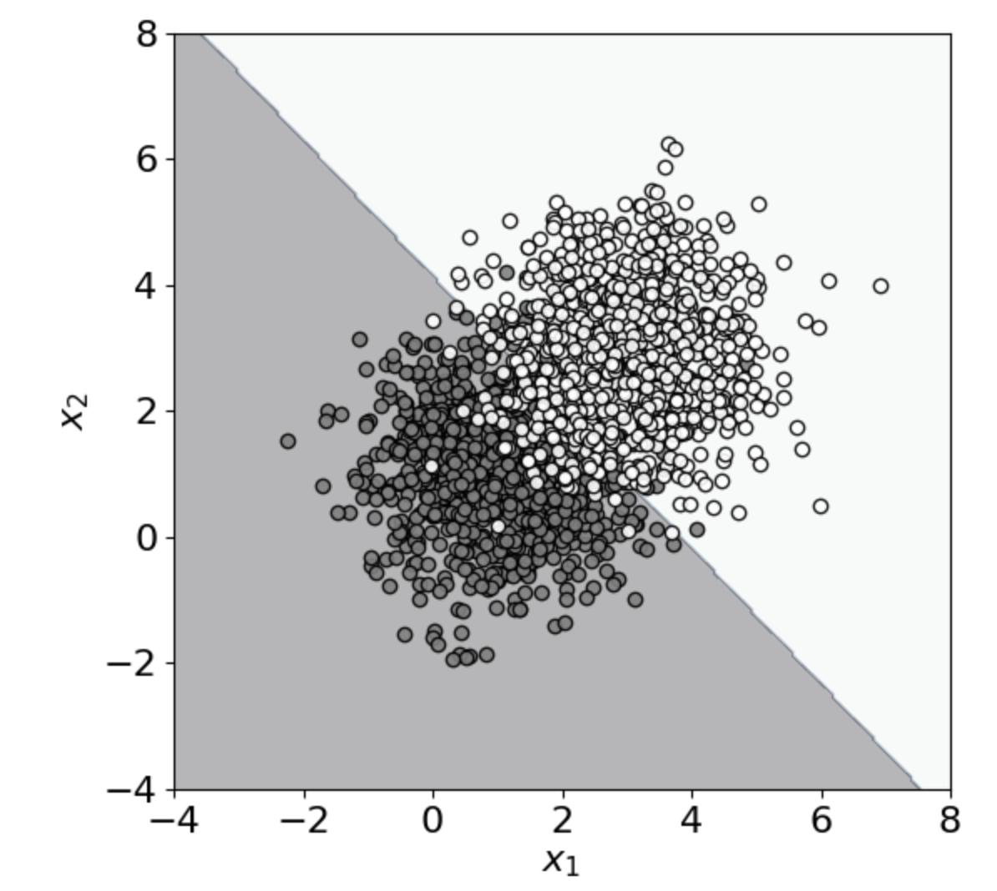
Unbalanced Dataset - Consequences
Class 1 (1000 points)
Class 0 (1000 points)
all points in this region are classified as Class 1
Decision boundary
all points in this region are classified as Class 0
Approx. 91% accuracy is achieved (with linear support vector classifier)

Slide 11
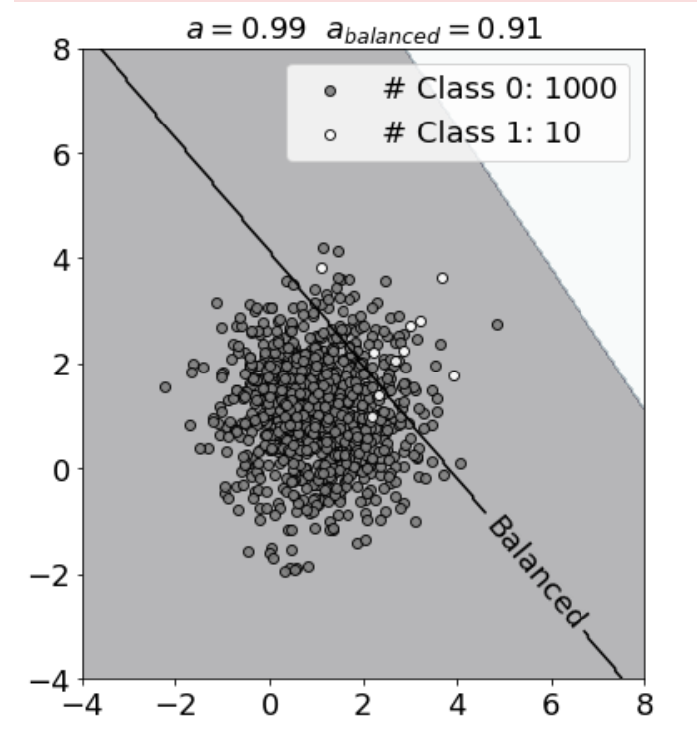
Unbalanced Dataset - Consequences
Class 1 (10 points)
Number of points in Class 1 is 1% Number of points in Class 0
Class 0 (1000 points)
all points in this region are classified as Class 1
Decision boundary with balanced dataset
Decision boundary
all points in this region are classified as Class 0
Approx. 99% accuracy is achieved (with linear support vector classifier)

Slide 12
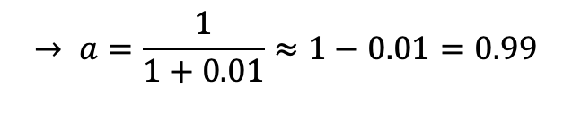
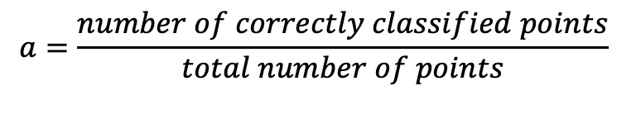
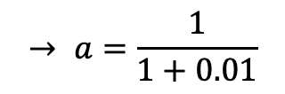
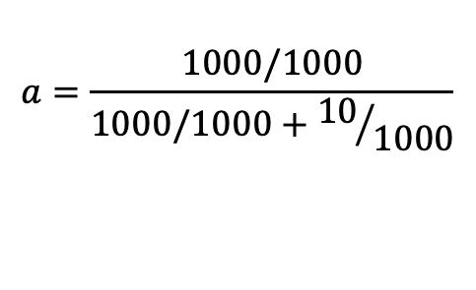
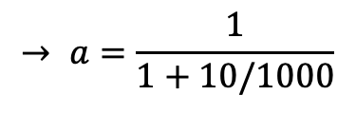
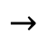
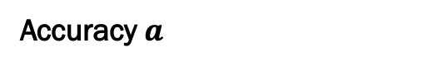
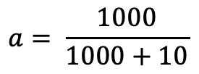
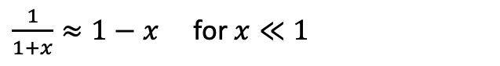
Unbalanced Dataset - Consequences
Number of points in Class 1 is 1% Number of points in Class 0
Class 1 (10 points)
Class 0 (1000 points)
Accuracy $a$
$$a=\frac{number of correctly classified points}{total number of points}$$
alle Punkte in dieser Region werden als Class 0 klassifiziert
$$a= \frac{1000}{1000+10}$$
$$a=\frac{1000/1000}{1000/1000+{10}/{1000}}$$
$$→$$
$$→ a=\frac{1}{1+10/1000}$$
$$→ a=\frac{1}{1+0.01}$$
$$→ a=\frac{1}{1+0.01}≈1−0.01=0.99$$
Don't forget:
$\frac{1}{1+x}≈1−x$ for $x≪1$
Approx. 99% accuracy is achieved (with linear support vector classifier)

Slide 13
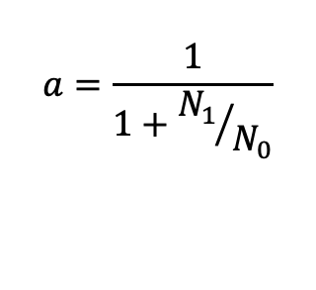
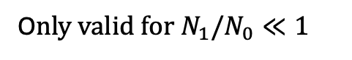
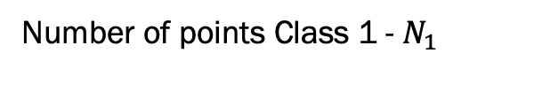
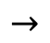
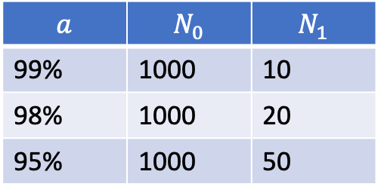
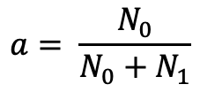
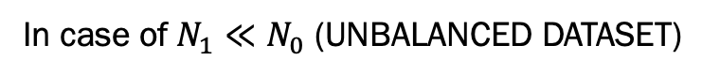
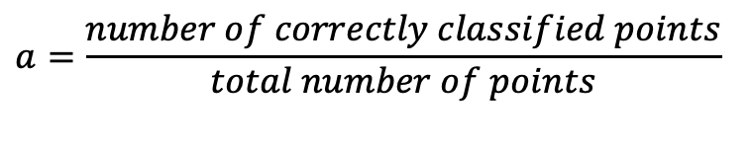
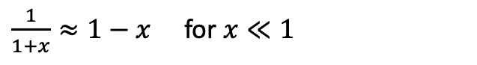
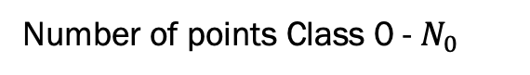
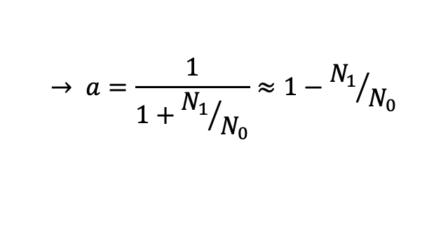
Unbalanced Dataset - Consequences
Number of points Class 1 - $N_{1}$
Number of points Class 0 - $N_{0}$
In case of$N_{1}≪N_{0}$ (UNBALANCED DATASET)
$$a=\frac{number of correctly classified points}{total number of points}$$
all points in this region are classified as Class 0
$$a= \frac{N_{0}}{N_{0}+N_{1}}$$
$$a=\frac{1}{1+{N_{1}}/{N_{0}}}$$
$$→$$
$$→ a=\frac{1}{1+{N_{1}}/{N_{0}}}≈1−{N_{1}}/{N_{0}}$$
O$nly valid for N_{1}/N_{0}≪1$
$$a$$ | $$N_{0}$$ | $$N_{1}$$
99% | 1000 | 10
98% | 1000 | 20
95% | 1000 | 50
Don’t forget:
$\frac{1}{1+x}≈1−x$ for $x≪1$

Slide 14
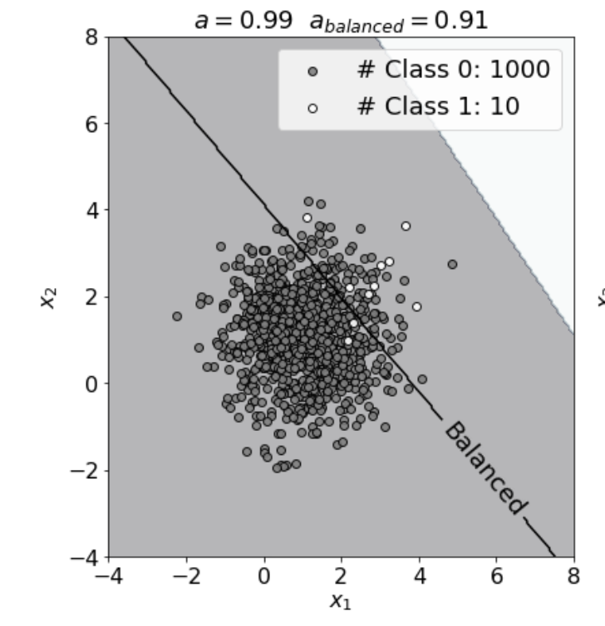
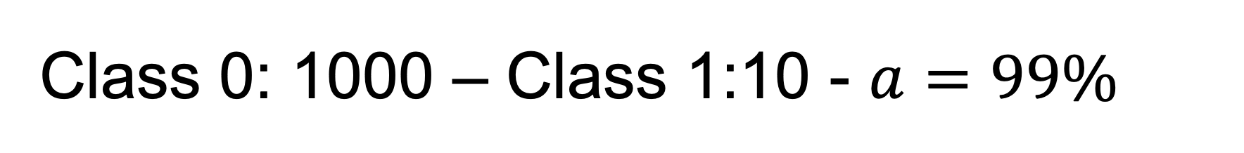
Class 0: 1000 – Class 1:10 - $a=99\%$
all points in this region are classified as Class 1
Decision boundary
all points in this region are classified as Class 0

Slide 15
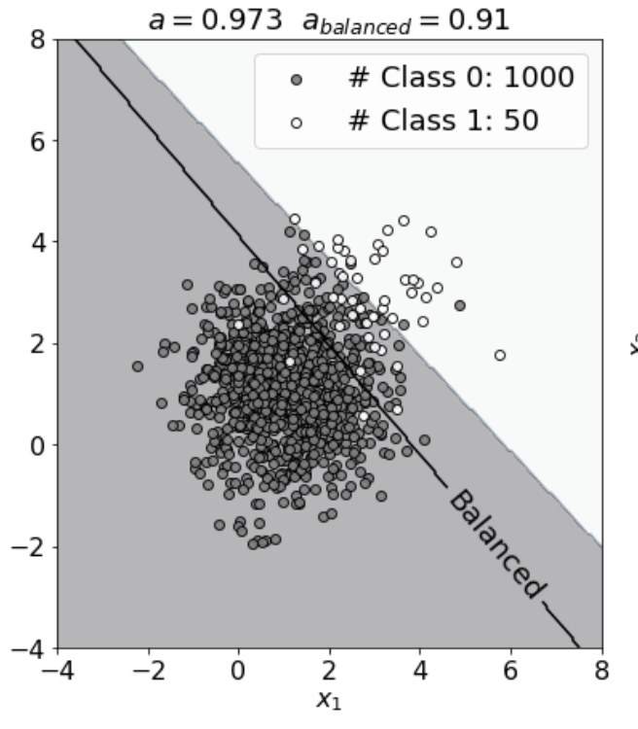
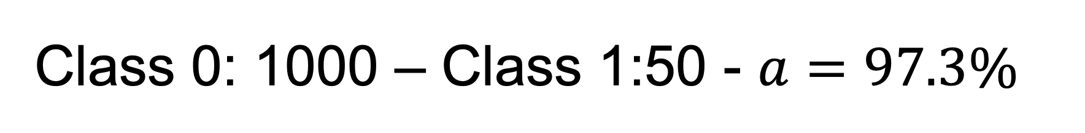
Class 0: 1000 – Class 1:50 - $a=97.3\%$
all points in this region are classified as Class 1
Decision boundary
all points in this region are classified as Class 0

Slide 16
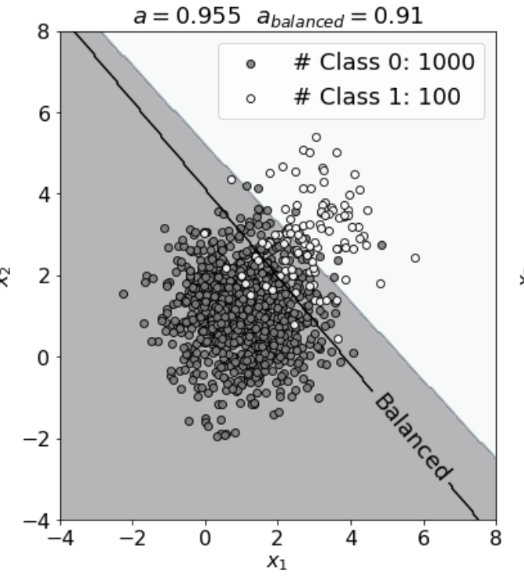
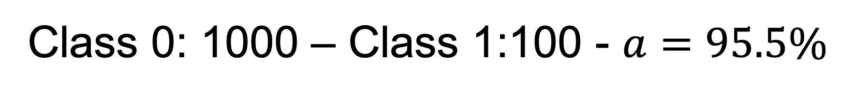
Class 0: 1000 – Class 1:100 - $a=95.5\%$
all points in this region are classified as Class 1
Decision boundary
all points in this region are classified as Class 0

Slide 17
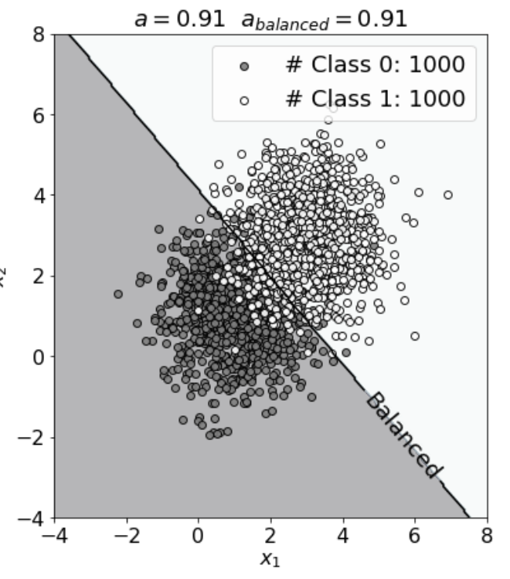
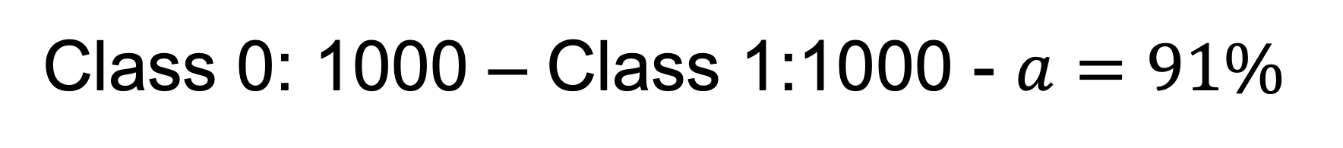
Class 0: 1000 – Class 1:1000 - $a=91\%$
all points in this region are classified as Class 1
Decision boundary
all points in this region are classified as Class 0

Slide 18
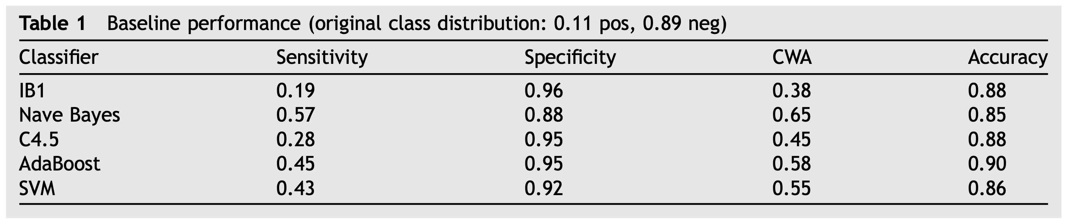
Real-life Scenario
Study on hospital-acquired infections: “Out of 683 patients, only 75 (11% of the total) were infected and 608 were not” (Cohen, Gilles, et al. "Learning from imbalanced data in surveillance of nosocomial infection." Artificial intelligence in medicine 37.1 (2006): 7-18)
(kNN)
(Decision Trees)
Sensitivity: the ability of a test to correctly identify patients with a disease
$$Sensitivity=\frac{TP}{P}=\frac{\text{"}\text{Number} \text{of} \text{inputs} \text{classified} \text{as}\text{ "}\text{sick}\text{" }\text{and} \text{have} \text{a} \text{true} \text{class} \text{of}\text{ "}\text{sick}\text{""}}{Number of sick patients}$$

Slide 19
Strategies for dealing with unbalanced data sets
Type 1 consists in the pre-processing of the data in order to restore the class balance. Type 2 consists of modifying the algorithms themselves so that they can handle unbalanced data.
Today we will deal with type 1.

Slide 20
Unbalanced Dataset - Solutions
1) Collect more data on the less represented class
2) Undersampling (subsampling) and oversampling
3) Use different metrics

Slide 21
Under- und Oversampling

Slide 22
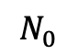
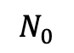
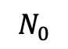
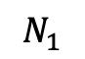
Oversampling
Class 0
Class 0
Class 1
Class 1
Original Dataset
Oversampled Dataset
$$N_{0}$$
$$N_{1}$$
$$N_{0}$$
$$N_{0}$$

Slide 23
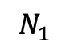
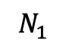
Undersampling (random undersampling)
Class 0
Class 0
Class 1
Class 1
Original Dataset
Oversampled Dataset
$$N_{0}$$
$$N_{1}$$
$$N_{1}$$
$$N_{1}$$

Slide 24
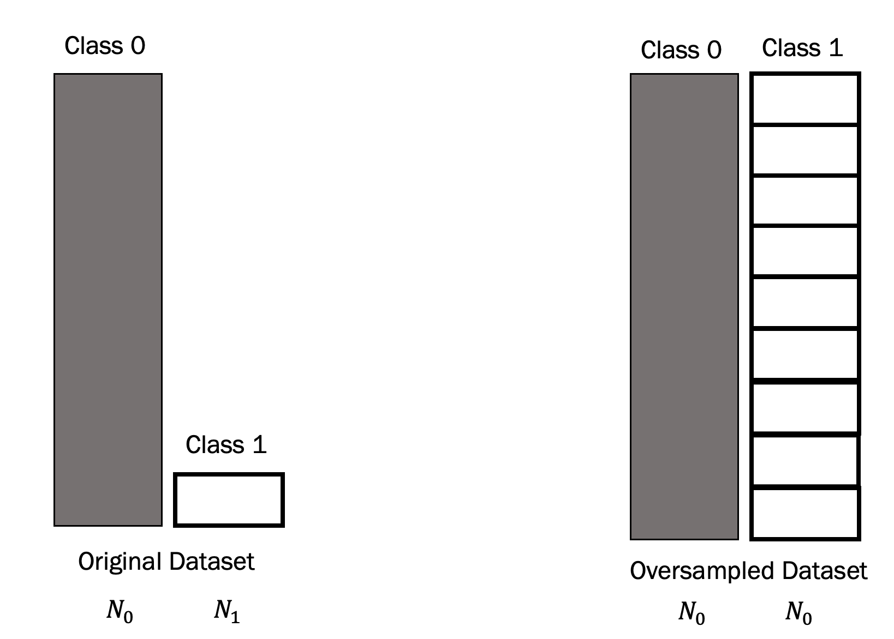
Advantages and disadvantages
Oversampling
Advantages:
You have a larger data set for training Disadvantages:
- The model generalizes worse because it has seen very few Class 1 cases

Slide 25
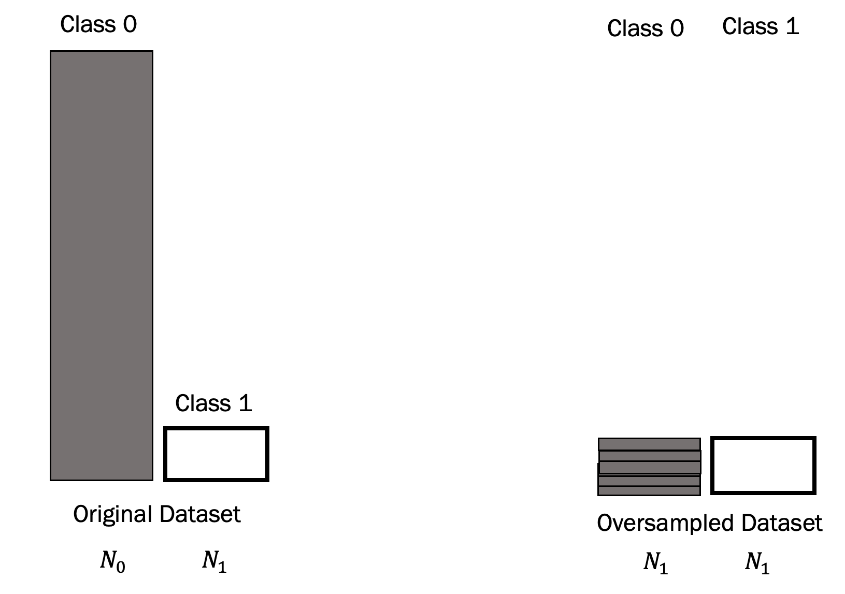
Advantages and disadvantages
Downsampling
Advantages:
You don't duplicate data
Disadvantages:
The training record is much smaller, and you lose a lot of data in class 0.
It can happen that the performance of the models quickly deteriorates with small data sets.

Slide 26
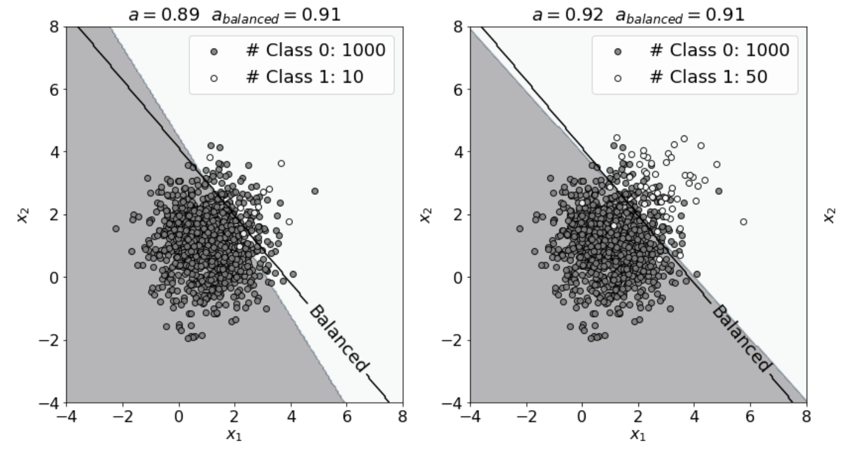
Oversampling

Slide 27
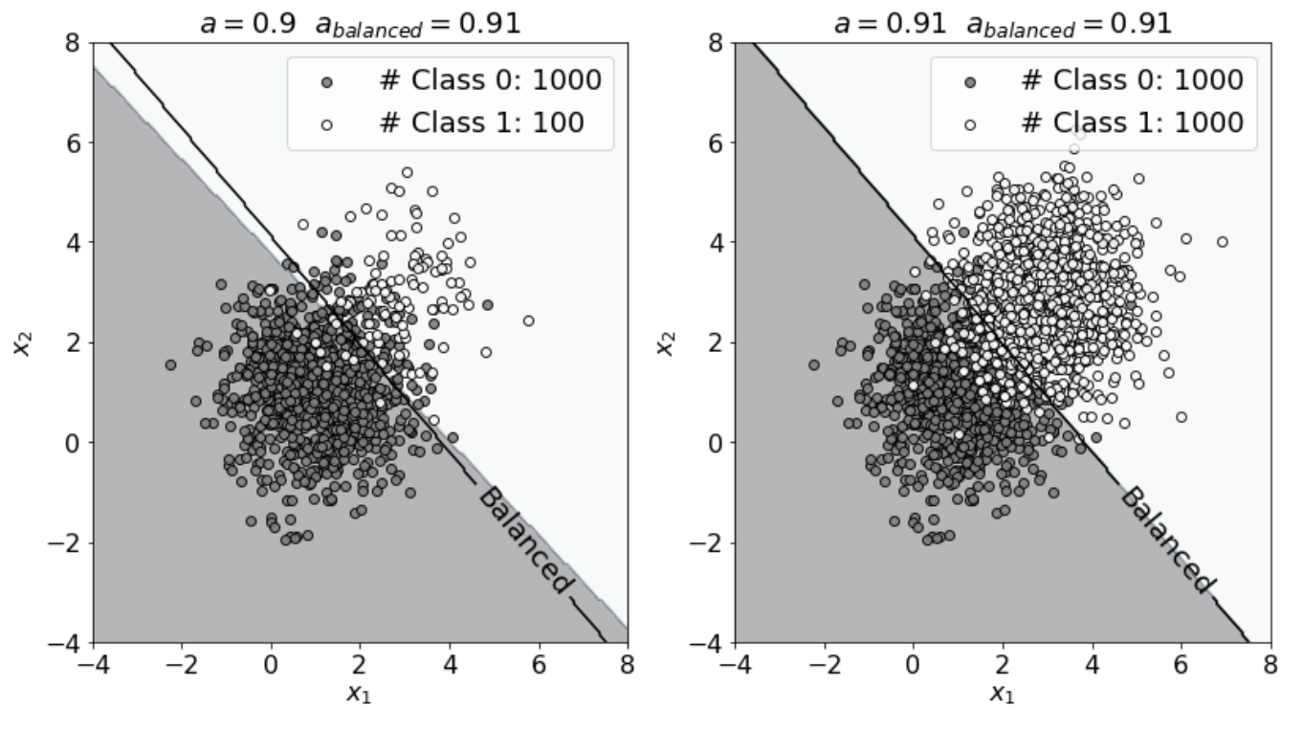
Oversampling

Slide 28
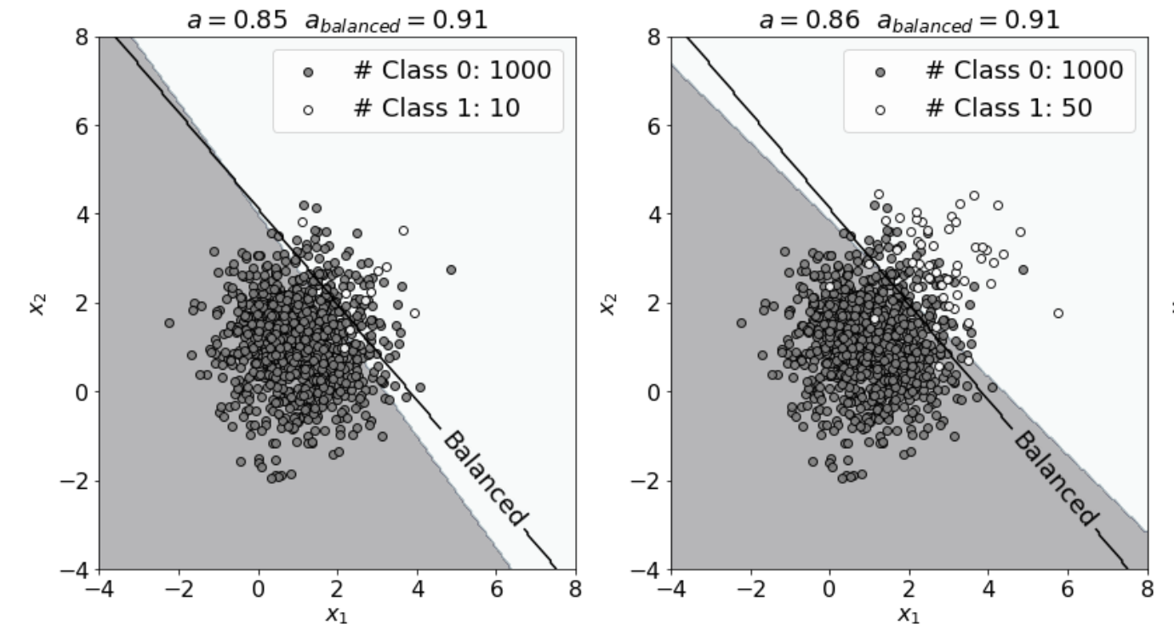
Undersampling

Slide 29
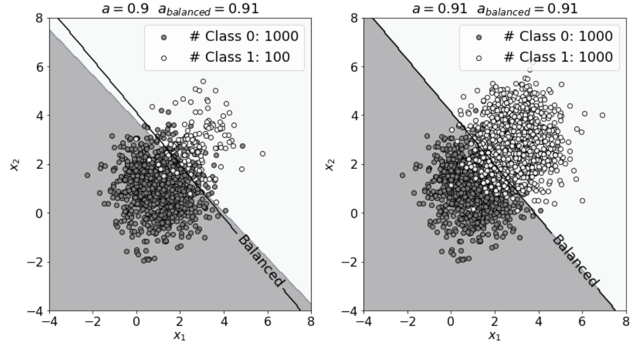
Undersampling

Slide 30
Metrics for Unbalanced Dataset Scenarios

Slide 31
Metrics - Overview
Binary Classification
Multi-class Classification
Metric | Discussed today | Metric | Discussed today
Accuracy | ü | Accuracy | ü
Specificity | ü | Accuracy pro class
Sensitivity | ü
Balanced Accuracy | ü
F1 Score | ü
Area Under The Curve (AUC / Receiving Operating Curve)
ü Confusion Matrix → Not really a metric (it contains multiple numbers)

Slide 32
Confusion Matrix (binary classification)
Number of inputs classified as 0 and that have a true class of 0 (TRUE POSITIVES, TP)
Number of inputs classified as 1 and that have a true class of 0 (FALSE NEGATIVES, FN)
In the case of the perfect classifier:
FN = 0 and FP = 0
True Label 0
Number of inputs classified as 0 and that have a true class of 1 (FALSE POSITIVES, FP)
Number of inputs classified as 1 and that have a true class of 1 (TRUE NEGATIVES, TN)
True Label 1
Predicted Label 0
Predicted Label 1

Slide 33
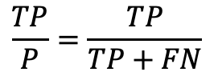
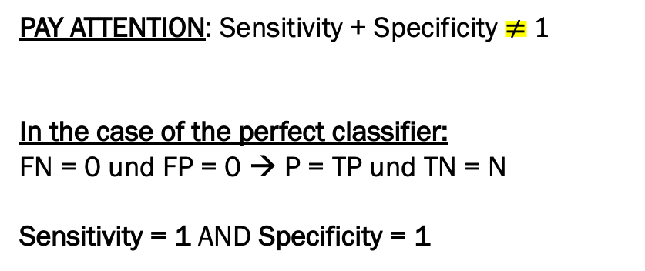
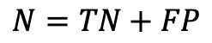
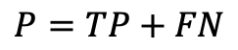
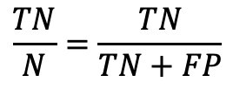
Sensitivity und Specificity
Sensitivity / Recall
True Positive Rate
$$\frac{TP}{P}=\frac{TP}{TP+FN}$$
How many of the cases in class 0 were correctly identified? "How many sick among all the sick have I identified?”
Specificity / selectivity
True Negative Rate
$$\frac{TN}{N}=\frac{TN}{TN+FP}$$
How many of the cases in Class 1 were correctly identified?
"How many healthy people among all healthy people have I identified?”
Confusion Matrix
PAY ATTENTION: Sensitivity + Specificity $≠1$
In the case of the perfect classifier:
FN = 0 und FP = 0 → P = TP und TN = N
Sensitivity = 1 AND Specificity = 1
TP
FN
$$P=TP+FN$$
True Label
FP
TN
$$N=TN+FP$$
Predicted Label

Slide 34

Balanced Accuracy
Sensitivity / Recall
True Positive Rate
$$\frac{TP}{P}=\frac{TP}{TP+FN}$$
How many of the cases in class 0 were correctly identified?
"How many sick among all the sick have I identified?"
Specificity / selectivity
True Negative Rate
$$\frac{TN}{N}=\frac{TN}{TN+FP}$$
How many of the cases in Class 1 were correctly identified?
"How many healthy people among all healthy people have I identified?”
Confusion Matrix
TP
FN
Balanced Accuracy = $a_{B}$ = $\frac{Sensitivity +Specificity}{2}$
$$P=TP+FN$$
True Label
FP
TN
$$N=TN+FP$$
Predicted Label

Slide 35

F1 Score
Sensitivity / Recall
True Positive Rate
$$\frac{TP}{P}=\frac{TP}{TP+FN}$$
How many of the cases in class 0 were correctly identified?
"How many sick among all the sick have I identified?"
Specificity / selectivity
True Negative Rate
$$\frac{TN}{N}=\frac{TN}{TN+FP}$$
How many of the cases in Class 1 were correctly identified?
"How many healthy people among all healthy people have I identified?”
Confusion Matrix
TP
FN
F1 = $\frac{2}{\frac{1}{Sensitivity}+\frac{1}{Specificity}}$
$$P=TP+FN$$
True Label
FP
TN
$$N=TN+FP$$
Predicted Label
* harmonic mean

Slide 36

Summary – confusion matrix

Slide 37


Class 0:1000 – Class 1:10 – Confusion Matrix
True Positives
False Negatives
= 100 %
= 0 %
Balanced Accuracy
False Positives
True Negatives
$$a_{B}=50\%$$

Slide 38


Class 0:1000 – Class 1:50 – Confusion Matrix
True Positives
False Negatives
= 99.7 %
= 50 %
Balanced Accuracy
False Positives
True Negatives
$$a_{B}=74.9\%$$

Slide 39


Class 0:1000 – Class 1:100 – Confusion Matrix
True Positives
False Negatives
= 98.9 %
= 61 %
Balanced Accuracy
False Positives
True Negatives
$$a_{B}=80\%$$

Slide 40


Class 0:1000 – Class 1:1000 – Confusion Matrix
True Positives
False Negatives
= 91.2 %
= 90.7 %
Balanced Accuracy
False Positives
True Negatives
$$a_{B}=91\%$$

Slide 41



Class 0:1000 – Class 1:10 – Confusion Matrix (mit vs. ohne Oversampling)
True Positives
False Negatives
False Negatives
True Positives
= 86.7 %
= 100 %
= 90.6 %
= 0 %
Balanced Accuracy
Balanced Accuracy
False Positives
True Negatives
$$a_{B}=88.7\%$$
$$a_{B}=50\%$$
False Positives
True Negatives
WITH OVERSAMPLING
WITHOUT OVERSAMPLING

Slide 42

Real-life Scenarios
Study on hospital-acquired infections: “Out of 683 patients, only 75 (11% of the total) were infected and 608 were not” (Cohen, Gilles, et al. "Learning from imbalanced data in surveillance of nosocomial infection." Artificial intelligence in medicine 37.1 (2006): 7-18)
$$a_{B}$$
(kNN)
0.58
0.73
(Decision Trees)
0.62
0.70
0.68
* CWA – Class Weighted Accuracy (proposed in the paper)

Slide 43

Real-life Scenarios
Study on hospital-acquired infections: “Out of 683 patients, only 75 (11% of the total) were infected and 608 were not” (Cohen, Gilles, et al. "Learning from imbalanced data in surveillance of nosocomial infection." Artificial intelligence in medicine 37.1 (2006): 7-18)
(kNN)
(Decision Trees)

Slide 44
Example – Images and Neural Networks

Slide 45
Question
Are neural networks smarter? Can they handle unbalanced records?
The goal is to convince you that what we've seen can happen with almost any algorithm.

Slide 46

Problem Description
I want to develop a classifier that distinguishes the 1 from all the others.
Number 1s: 6742 (11.2%)
Number 0,2,3,4,5,6,7,8,9: ca. 53258 (88.8%)
Handwritten digits – 28x28 pixel images

Slide 47
Confusion Matrix 1 vs. all (MNIST)
0
6742
True Label 1
0
53258
True Label
0,2,3,4,5,6,7,8,9
* Not relevant: Results of a neural network with 1 neuron with sigmoid activation function.
Predicted Label
0,2,3,4,5,6,7,8,9
Predicted Label 1

Slide 48
Receiving Operating Curve (ROC)
The ROC curve is a very important method for studying binary classification metrics. It is used to derive the Area Under the Cruve (AUC) metric.

Slide 49
ROC Curve (I)
An ROC curve (receiver operating characteristic curve) is a graph showing the performance of a classification model at all classification thresholds. This curve plots two parameters:
True Positive Rate (TPR)
False Positive Rate (FPR)
How can we draw the curve? A model has only one value for TPR and FPR!
https://developers.google.com/machine-learning/crash-course/classification/roc-and-auc

Slide 50

ROC Curve (II) - Derivation
Let us suppose we have a model that has, as output, the probability ${\hat{y}}_{i}$ of an observation $x_{i}$ of being in class 1.
The input observation is classified according to the following rule¹⁾
$$\left\{\begin{aligned}Class 1 if {\hat{y}}_{i}>α \\ Class 0 if {\hat{y}}_{i}≤α\end{aligned}\right.$$
With $α∈[0,1]$ is a real number. Normally one chooses $α=0.5$.
¹⁾ For the more mathematical savy of you, this is the translated Heaviside step function.

Slide 51




ROC Curve (III) - Derivation
For each value of $α$ one get a value of TPR$(α)$ and FPR$(α)$.
The ROC curve is obtained by plotting TPR$(α)$ and FPR$(α)$ by varying $α$ from 0 to 1.
$α=0$ – All observations
Classified as in class 1
$TPR=TP/P$ TP (True Positive) = P (Positive) → TP/ P = 1
1
TPR
$α=1$ – All observations
Classified as in class 0
$TPR=TP/P$ TP (True Positive) = 0 (Positive) → TP/ P = 0
A value of $α$ between 0 and 1
1
FPR

Slide 52

ROC Curve (IV) – AUC (Area Under the Curve)
To get a general metric on all possible cases (or possible $α$), the area under the curve (indicated with A) is often given as a metric.
$α=0$ – All observations
Classified as in class 1
$TPR=TP/P$ TP (True Positive) = P (Positive) → TP/ P = 1
1
TPR
$α=1$ – All observations
Classified as in class 0
$TPR=TP/P$ TP (True Positive) = 0 (Positive) → TP/ P = 0
A
A value of $α$ between 0 and 1
1
FPR

Slide 53
Metrics for Multi-Class Problems
Multiclass classification is the problem of classifying instances into one of three or more classes.
e.g. diabetes type I, II or "gestational".

Slide 54
Metrics - Overview
Binary Classification
Multi-class Classification
Metric | Discussed today | Metric
Accuracy | ü | Accuracy | ü
Specificity | ü | Accuracy pro class
Sensitivity | ü
Balanced Accuracy | ü
F1 Score | ü
Area Under The Curve (AUC / Receiving Operating Curve)
ü Confusion Matrix → Not really a metric (it contains multiple numbers)

Slide 55
Confusion Matrix (Multi-class classification)
Number of inputs classified as 0 and that have a true class of 0
Number of inputs classified as 1 and that have a true class of 0
Number of inputs classified as 2 and that have a true class of 0
…
True Label 0
Number of inputs classified as 0 and that have a true class of 1
Number of inputs classified as 1 and that have a true class of 1
True Label 1
…
…
…
…
…
Predicted Label 0
Predicted Label 1
Predicted Label 2

Slide 56

Quiz: Classifier is good or bad?
Kwon, Hyun, et al. "Random untargeted adversarial example on deep neural network." Symmetry 10.12 (2018): 738.

Slide 57

Quiz: Classifier is good or bad?
Oyedotun, Oyebade K., Djamila Aouada, and Bjorn Ottersten. "Improving the capacity of very deep networks with maxout units." 2018 IEEE International Conference on Acoustics, Speech and Signal Processing (ICASSP). IEEE, 2018.

